Slide 1

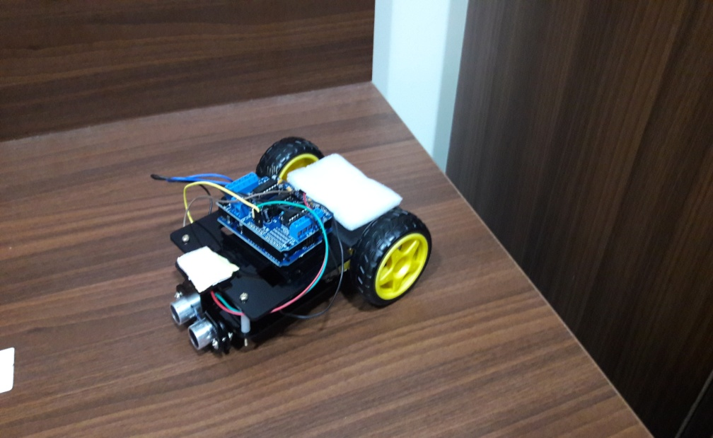
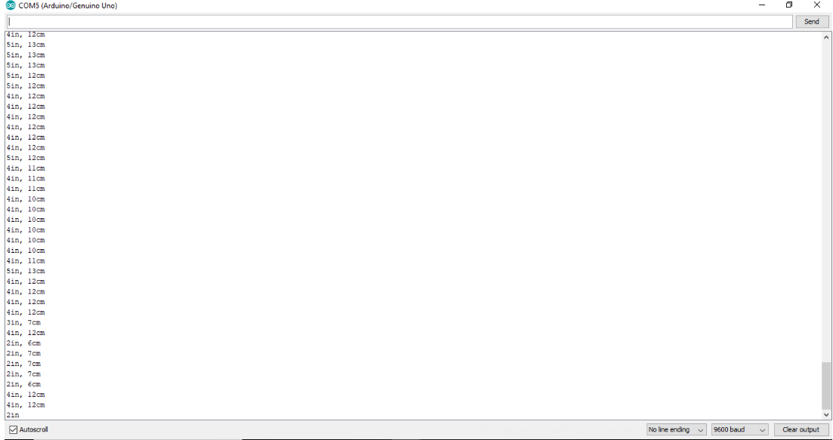
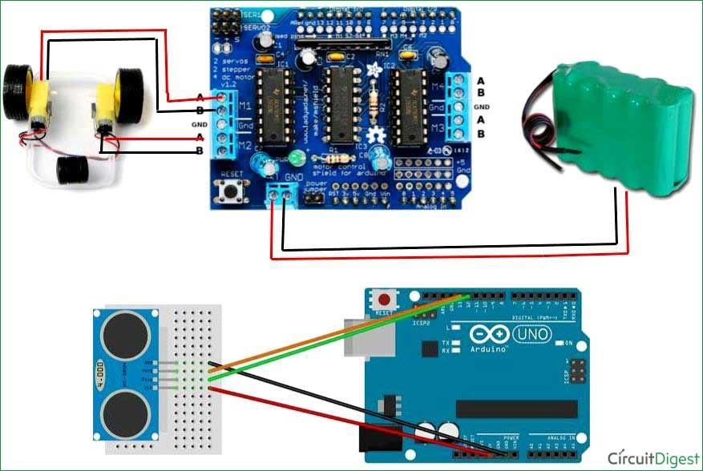
Arduino Based Floor Cleaning Autonomous Robot
Aman Potdar|Guided by:- Prof Nandha Kumar | Vellore Institute of Technology, A.P
Motivation
We all know that all the work which needed to clean the floors of the house is done by humans.
It is a tiring process too, where a person requires lot of time and energy to complete it.
We know that many companies in Japan and Russia and also many universities like Stanford and MIT are continuously trying to make robots which can replace humans for cleaning the floors of the house, but the issue behind them that if they release those robots in market or make them commercially available, they would be priced on a higher side, since it requires lot of components like cameras and motors which need to be installed in them which require a lot of money. Therefore such robots would be bought by the rich and the affluent, and a common man cannot afford them as today. So we decided to come up with a simple Arduino based floor cleaning robot which can clean the floors of houses and offices in an efficient and simple way.
Results
The below is the prototype of our project , which can now efficiently clean the floors of homes and offices in a simple an efficient manner.
SCOPE of the Project
If we talk about the scope for this project , this project has a large scope in the market (especially in developing countries in India where most of the work done to clean the floor is done manually. )
Our ABFCRU can efficiently clean the floor of a house in minutes without any effort from a human being.
Our Model
Methodology
Arduino UNO, UltraSonic Sensor and Motor Driver Shield form the important and significant components our project.
After uploading different codes in our Arduino Board, and testing them for several months we finally came up with a suitable code which could meet our project’s target.
Our UltraSonic Sensor detects any obstacle in front of it at a distance of approximately 20cm with the help of an ECHO, and if it detects any it would send back a signal to the Arduino board which in turns sends signals to our DC motors to turn their direction to the right/left.
In this entire process in whichever path the Model follows (which has a Scotch Brite attached to it), it would clean the path on its way ( in case any dirt is present on its way).
The below is very rough circuit diagram of our project
Serial port monitor of Arduino which detects the distance of the obstacle in front of it.
Conclusion
We have successfully achieved our target of developing
an efficient and simple Arduino based floor cleaning
Robot which runs on a 9V battery with the
help of a suitable power source.
Contact Details
saipujitha.kamatam@vitap.ac.in
aman.potdar@vitap.ac.in
abhishek.perumalla@vitap.ac.in
swetanjani.jakireddy@vitap.ac.in
nandha.r@vitap.ac.in
Acknowledgments/ References
www.tutorialspoint.com
www.instructables.com
www.circuitdigest.com

